Slide 1
Lineup D3 Implementation
University of San Francisco
Wentao Du
Siwei Zhang
Kaijie Zhou

Slide 2
Introduction of Lineup Project
D3 Implementation
Demo
Conclusion and Future Work

Slide 3
Introduction of Lineup Project

Slide 4
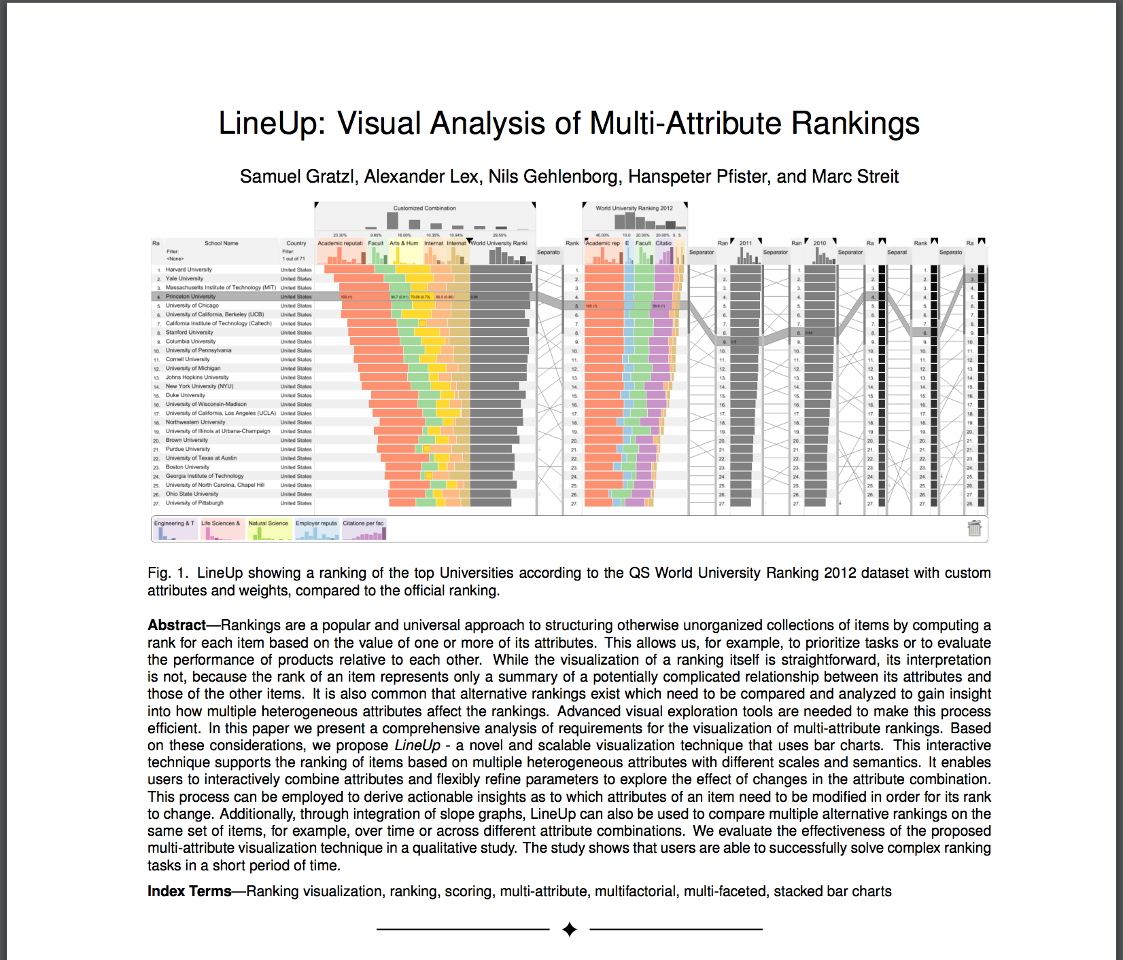
What is Lineup?
Lineup: Visual analysis of multi-attribute rankings
Lineup is a visualization tool for multi-attribute rankings.
e rankings.

Slide 5

Why use Lineup?

Slide 6
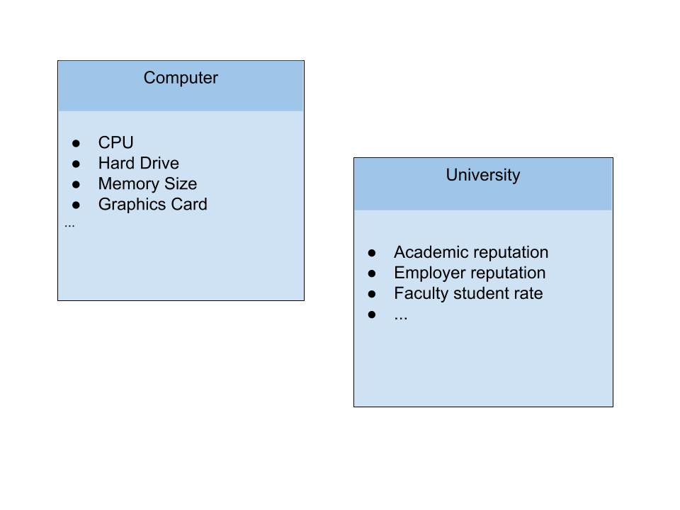
Why use Lineup?
Multi-attribute things exist everywhere.

Slide 7

Why use Lineup?
It’s hard to compare items with multi-attribute.
A University with higher academic reputation？
A University with higher employer reputation？

Slide 8
Why use Lineup?
It’s even harder if attributes are with different weight.

Slide 9
How Lineup Works
Transform each attribute into a numeric score.
Rank items based on the scores and their weight.
Let user change the weight of each attribute by changing the width of that column.
Re-rank by the new weight set.
Use color to indicate the ranking change.

Slide 10
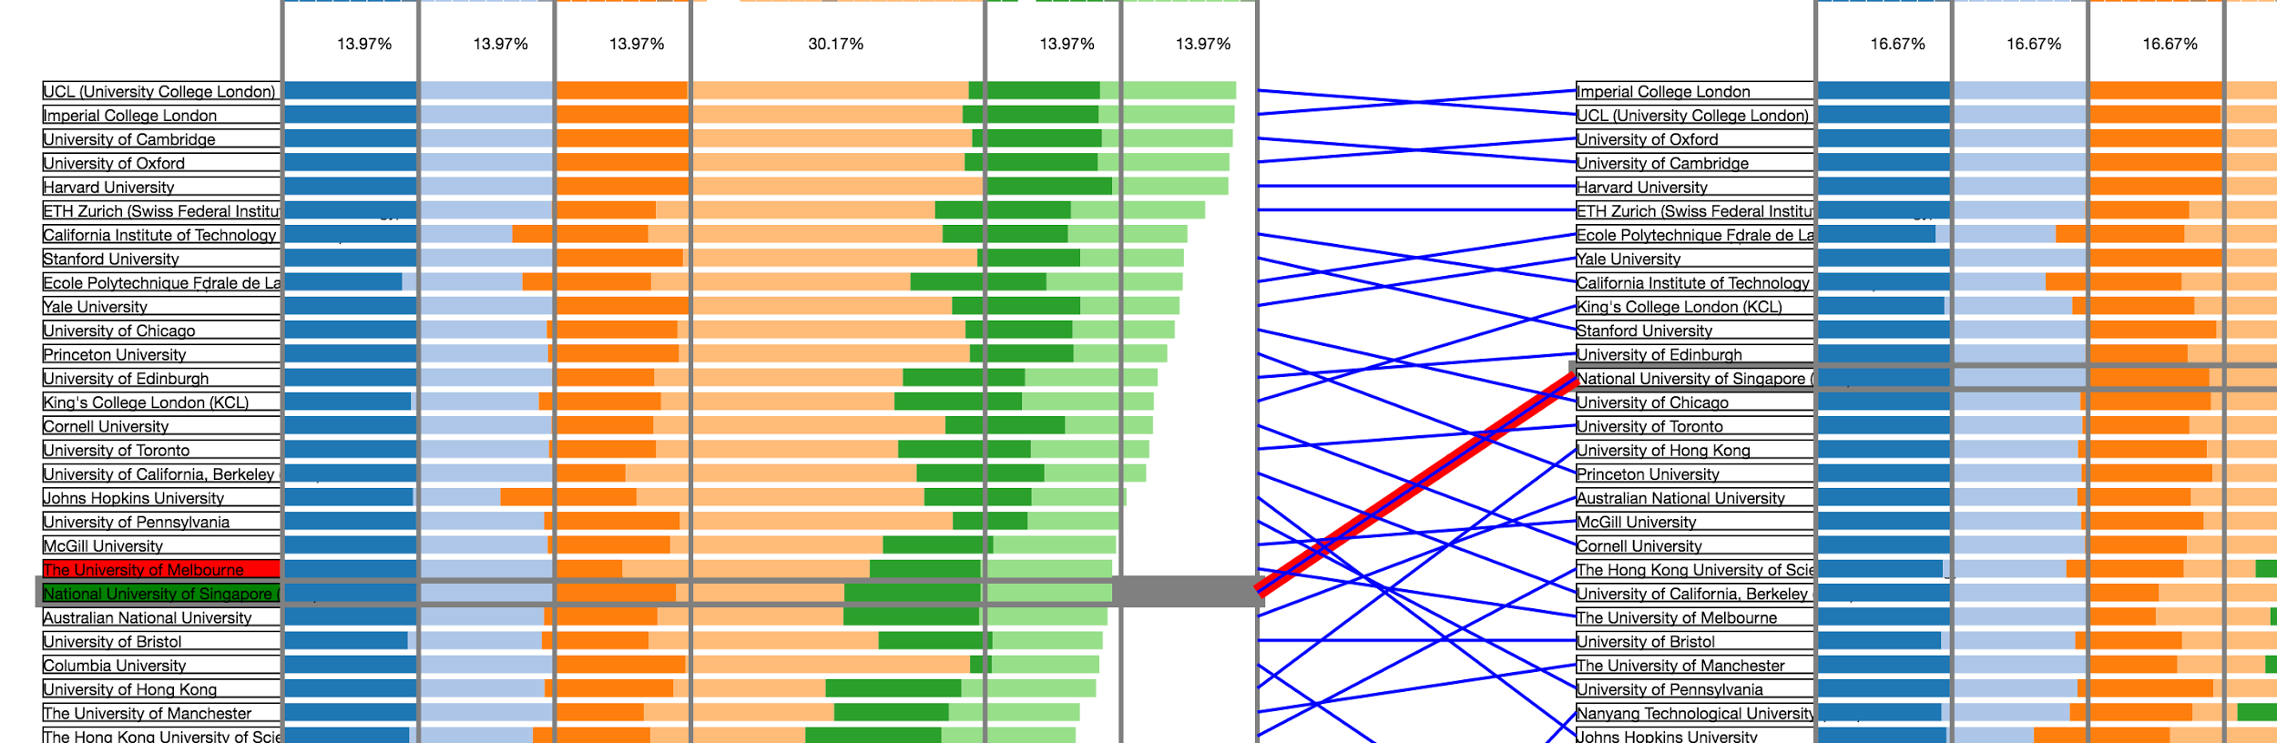
How Lineup Works
Show multiple ranking at same time.
Lineup the same item in different rankings

Slide 11
D3 Implementation

Slide 12



D3 implementation - Tools

Slide 13
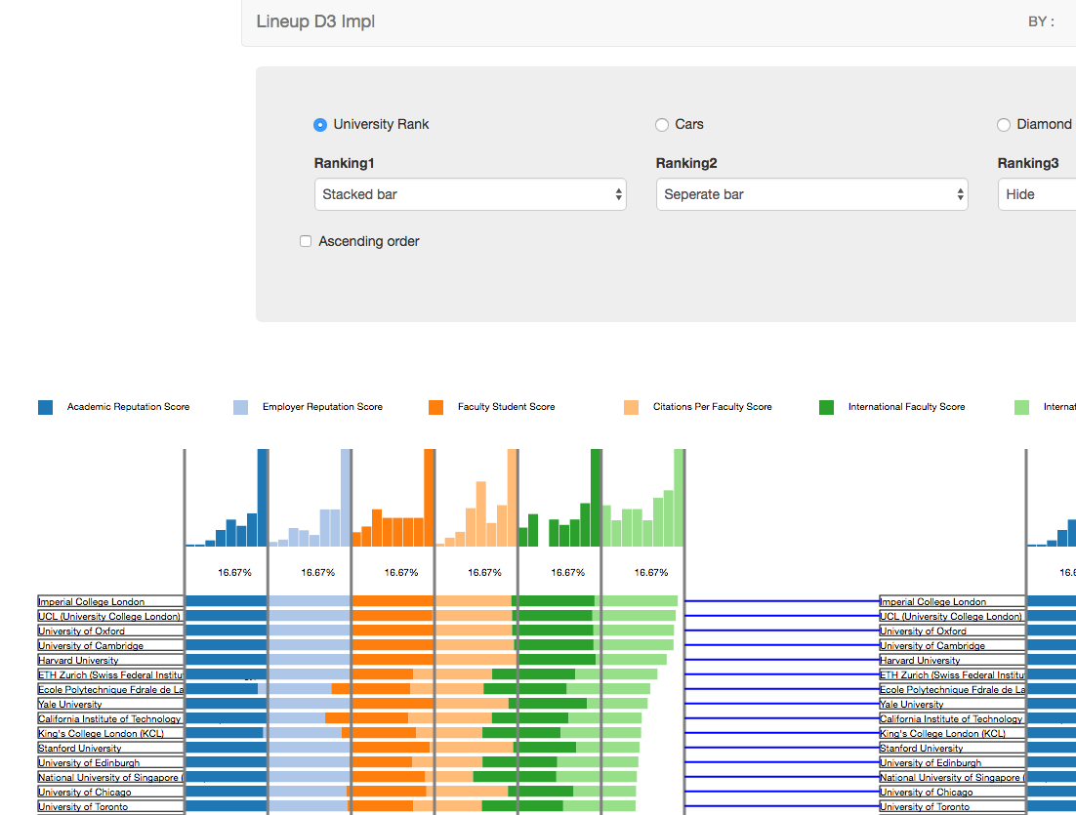
D3 implementation - Pipeline
Metadata
new dataset
Clean up the data set.
Convert original data to score
Clean NaN data
Create metadata file
Specify which columns to show
Specify the path of data source
Original dataset

Slide 14
Demo

Slide 15
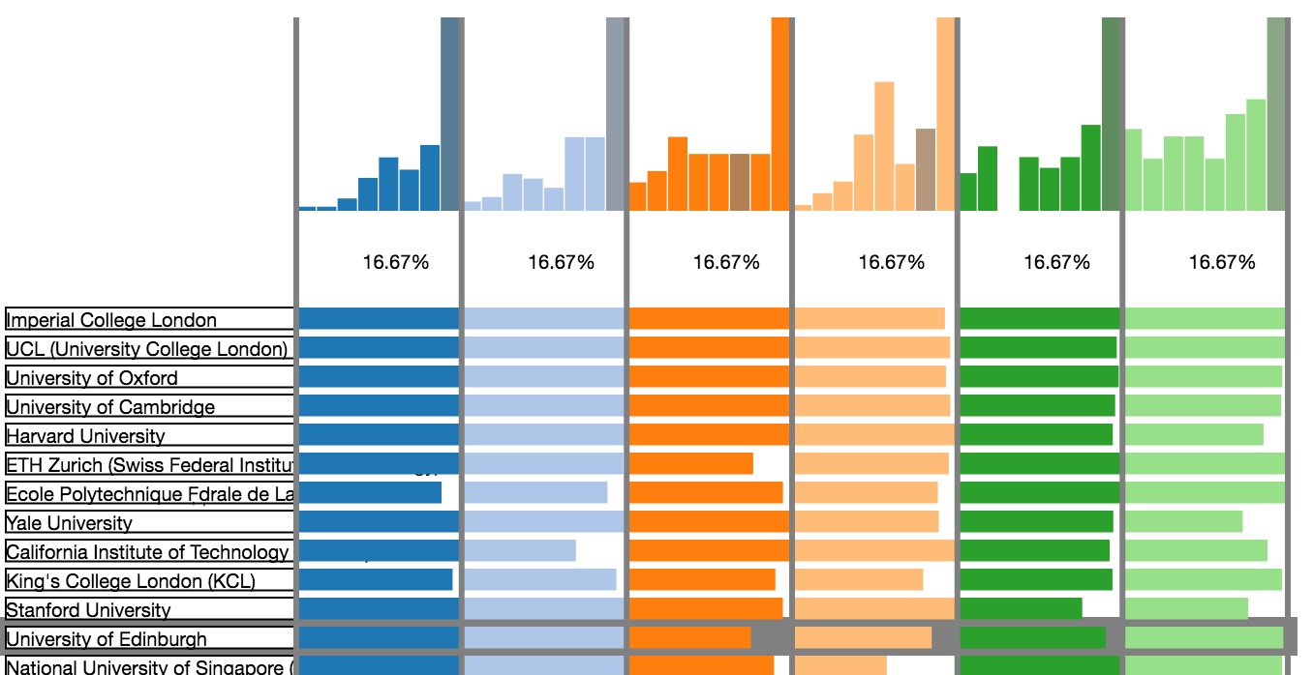
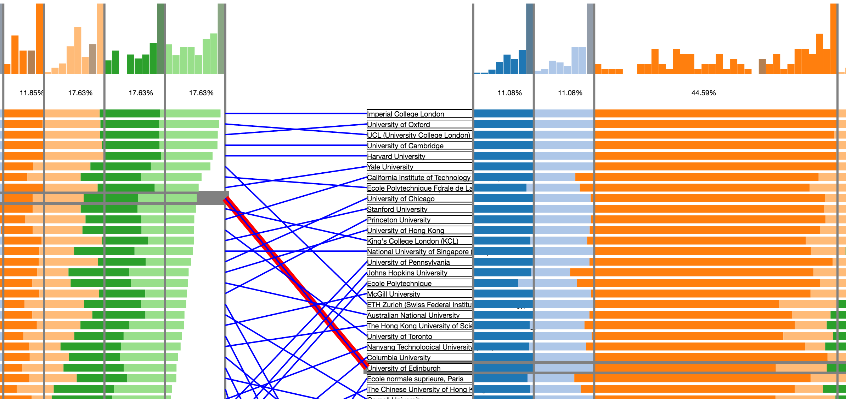
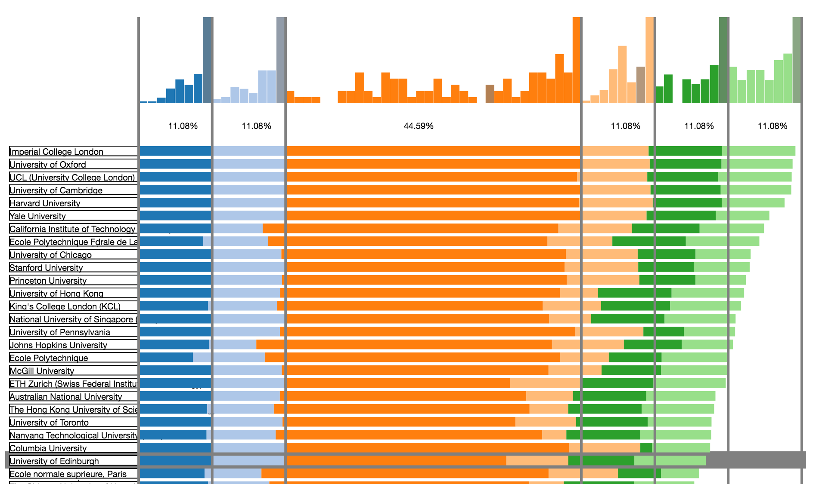
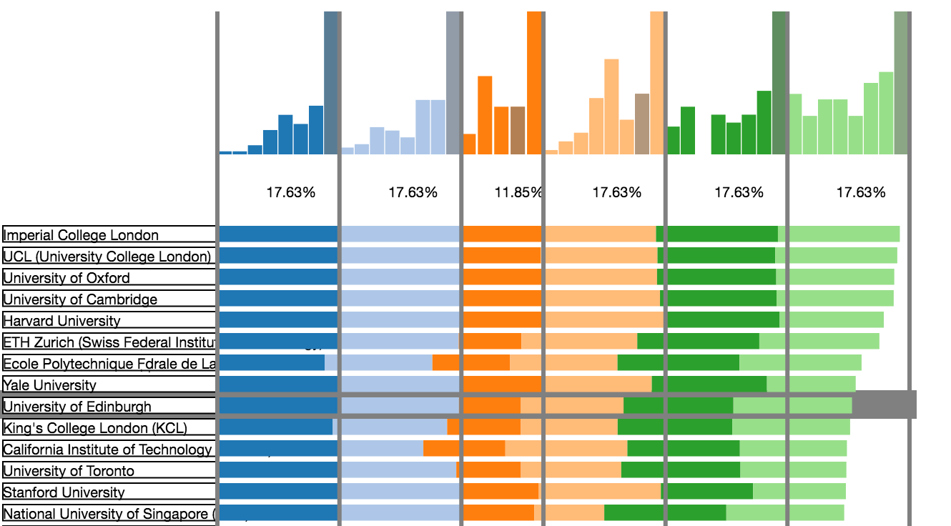
Notes:
For the data part, we can easily see the rank of a certain item changes a lot when we modifying one of its aspects. For example, University of Edingburgh is one of the top 10 university when the weight of Faculty Student score is low. But it drops when we add weight on that attribute.
A Line Up graph shows this change apparently, with the line linking two stacked bar chart. We also find that the top five schools don’t change when we doing so. The reason is easy to guess: they have similar scores in Faculty Student rate while University of Edinburgh has a relatively lower score in this attribute which makes it rank down when we add weight to the aspect. A separated bar chart supports this idea and makes it clear.

Slide 16
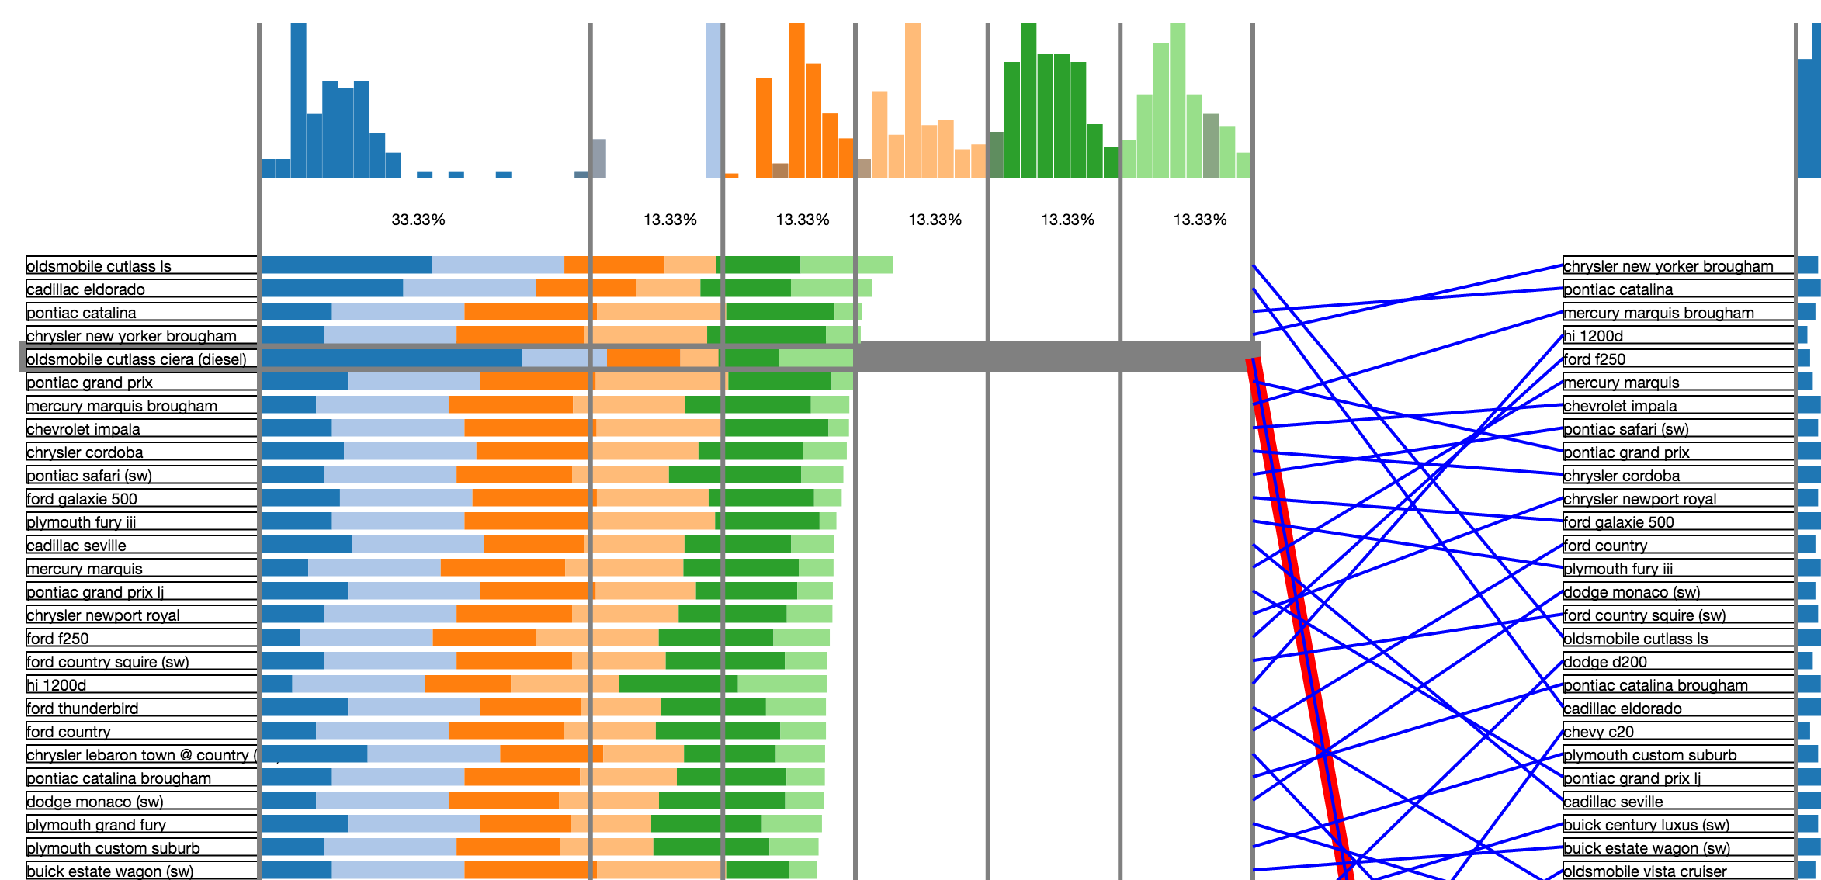
Notes:
Good universities may have common things that make them outstanding. But when it comes to cars, it really depends on what you need. The left part of this graph shows the result of changing the weight of MPG Score to one-third and the right part is the graph that each attribute has same weight. The lines between the charts are kind of messy, which may indicates that if you really focus on one certain aspect of a car, you need to sacrifice on other demands.

Slide 17
Lessons and Challenges
Got familiar with D3
Simple visualization techniques can be combined into a new technique to solve more complicated problem.
Building a visualization tool can face lots of challenges
Data cleaning is something we must do for every real data set
Sorting data takes O(nlgn) time, which mainly affects the performance of the system.
Notes:
During doing this project, we got familiar with D3(of course), as well as other techniques. We used different simple visualization techniques to create a new one to solve more complicated problems. There are lots of challenges as well.

Slide 18
Conclusion and Future Works

Slide 19
Conclusion
Introduced Lineup project
--a visualization tool for multi-attribute rankings.
We implemented:
stacked and separated bars with different weights
histogram of each attribute
line up
support different datasets

Slide 20
Future Works
Try on more data sets
Refine the fonts and colors we use
Add more function to generate scores

Slide 21
Questions?

Slide 22
Thank you!
You can check the Project Through:
http://victordu.github.io/LineUp-D3/

